Slide 1

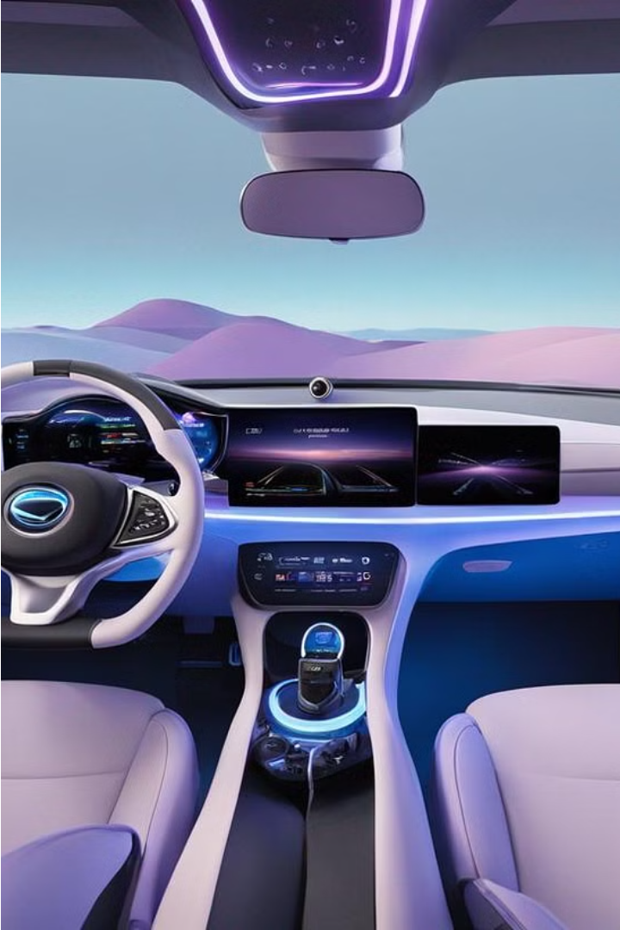




Design and Development of a Human-Agent Collaboration Model for Situation Awareness in Cockpit
by Yitong Hu

Slide 2

Table of Content
1
Background
2
My Solution: HCockpit & HCopilot
3
Design and Implementation
4
Demonstration
5
Conclusion and Future Work

Slide 3

1. Background
1
The Challenges of Full Autonomous Driving
Level 5 autonomous driving still faces challenges from technology, legal issues, and ethics. Thus, OEMs are adopting L2 and L3 autonomous features (ADAS).
2
Human-Centered Driving
For the foreseeable future, humans will remain at the core of driving. Human-Centered Driving aims to enhance the driving experience and safety for humans.
3
Human-Agent Collaboration
Designing effective collaboration mechanisms between human drivers and ADASs is crucial for Human-Centered Driving.

Slide 4
1.1 Challenges and Requirements
Advanced Driver Assistance Systems (ADASs) may intermittently require human re-engagement in vehicle operation. Conversely, drivers may need the support of ADASs in certain scenarios…Understanding and predicting the human driver’s intentions is critical to this two-way cooperative process.
Establishing an efficient, transparent communication mechanism between ADASs and human drivers to ensure rapid and accurate information exchange at critical moments is a significant challenge…
How to process and integrate information from various sensors and data sources to achieve accurate situation awareness is a key issue in system design…
Excerpt from the Literature Review and Requirements Analysis of this project.

Slide 5
1.2 Motivation
Design and develop a Human-Agent Collaboration model considering
human driver's intention
communication mechanism
to improve human-centered driving in:
User Experience (UX)
Security
Intention-Based Implicit Interaction
Low Attention Alerts
Driver Situation Awareness Enhancement
Potential Threat Alerts
ADAS Preferences Suggestion
Autonomous Emergency Takeover
Excerpt from the Software Feature List of this project.

Slide 6
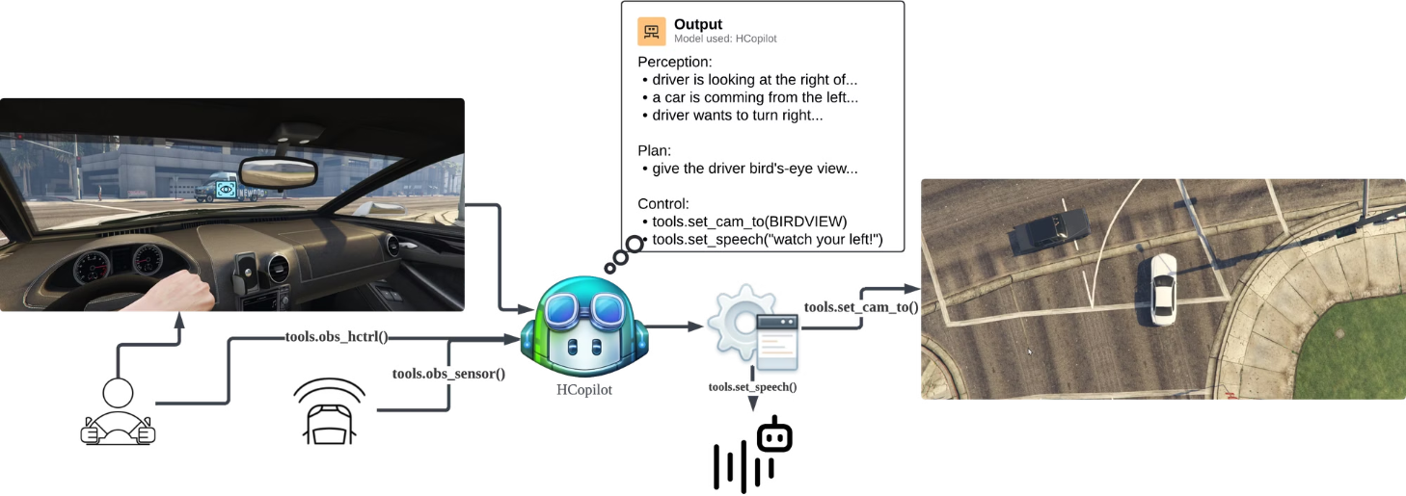
2. My Solution:
HCockpit and HCopilot

Slide 7

3. Design and Implementation
1
HCockpit Architecture
2
HCopilot Implementation
HCopilot is an agent developed following HCockpit architecture.

Slide 8
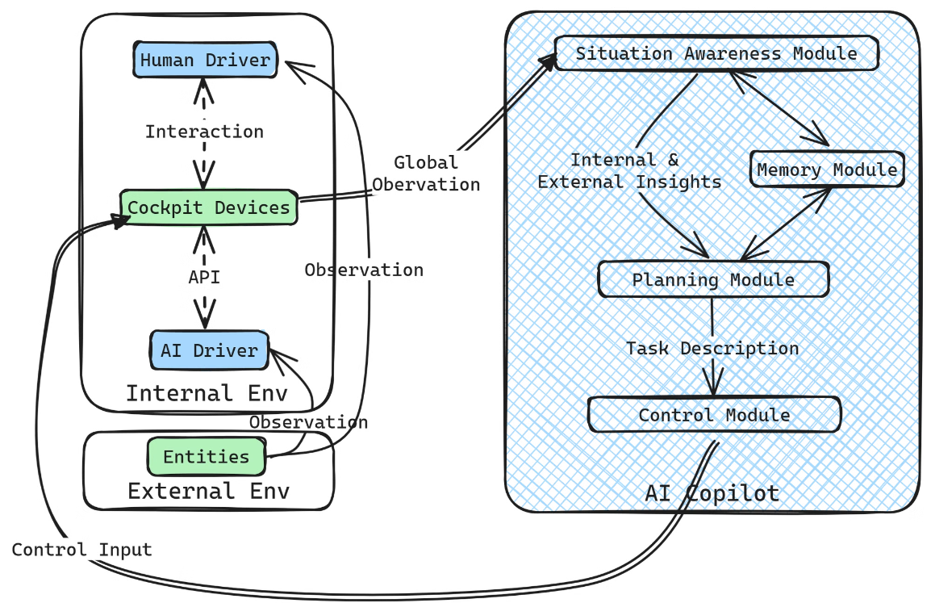
3.1 HCockpit Architecture
Design Basis: The Rise and Potential of Large Language Model Based Agents: A Survey

Slide 9
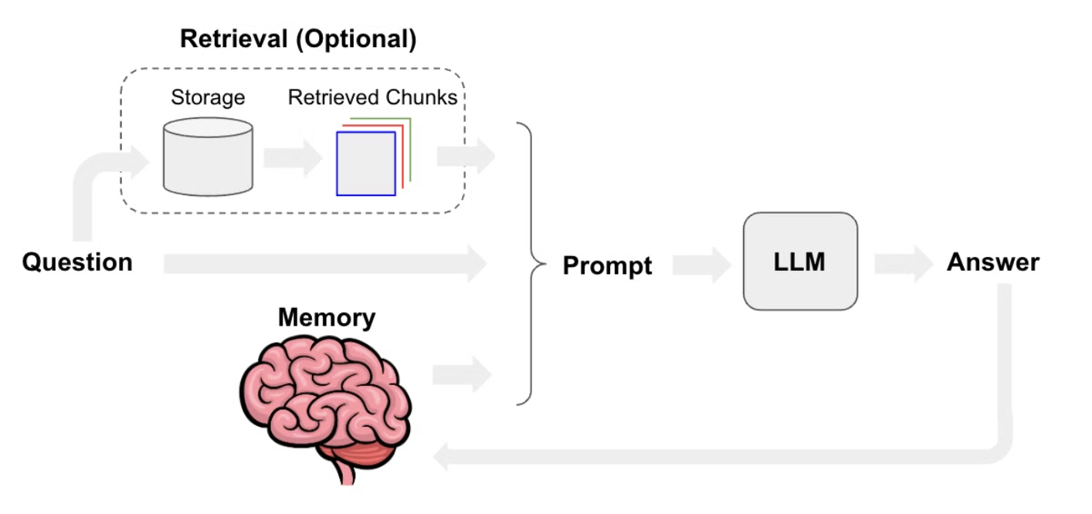
3.1.1 Context Awareness
Inspired by ChatGPT architecture.

Slide 10

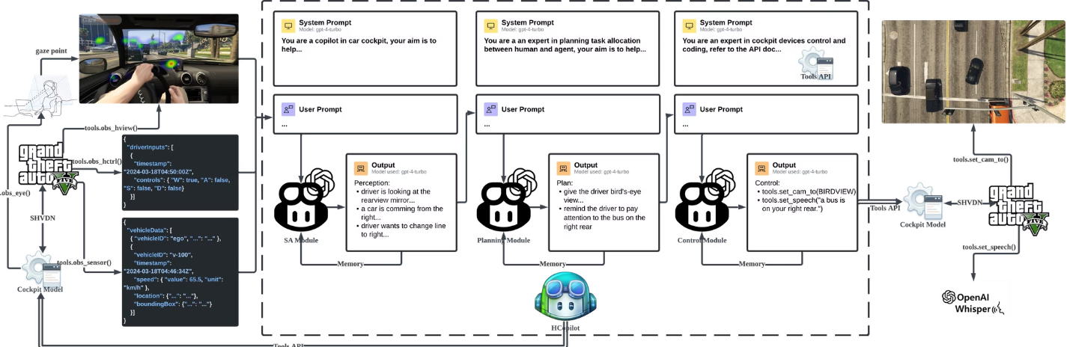
3.2 HCopilot Implementation

Slide 11
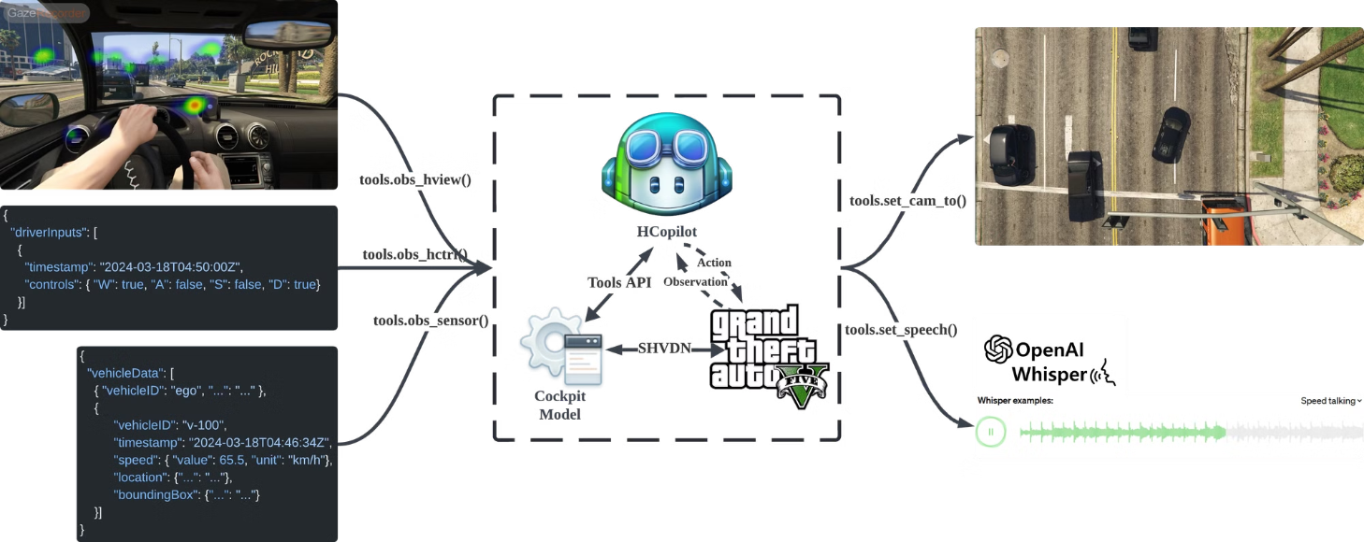
3.2.1 Tools API
References: Script Hook V, SHVDN, GTAV and Whisper.

Slide 12
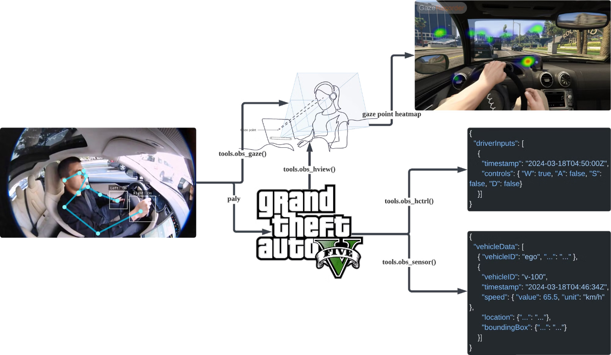
3.2.2 Data Collection
Tools used: iVCam, Beam Eye Tracker and OpenTrack.

Slide 13
3.2.3 Prompt Engineering
1. Tactics (under the guide from OpenAI)
1
Include detailed information in the query to obtain more relevant answers.
2
Ask the model to adopt a persona.
3
Use delimiters to clearly indicate different parts of the input.
4
Follow the chain-of-thought (CoT) prompting, specifying the steps required to complete the task.
5
Provide examples.
Prompt, also known as the input to LMM, is the description of the input data and the tasks.

Slide 14
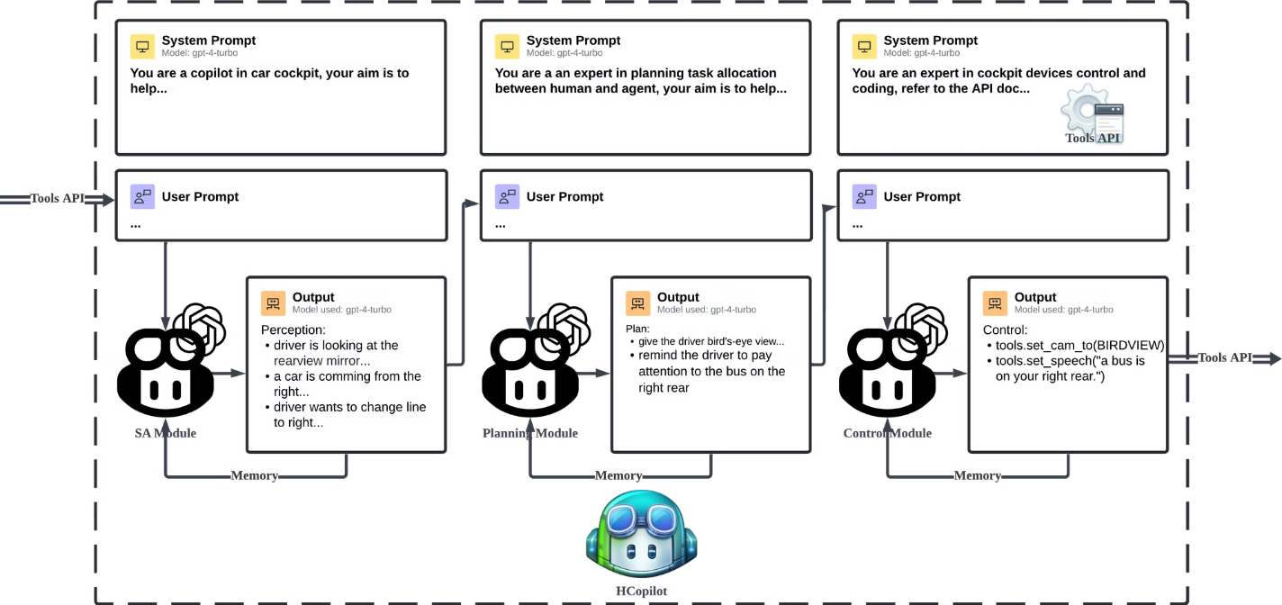
2. LMMs Chain
Implemented using LangChain, an open-source framework to dev apps powered by LMMs.

Slide 15

3.2.4 Overall Workflow

Slide 16


4. Demonstration

Slide 17
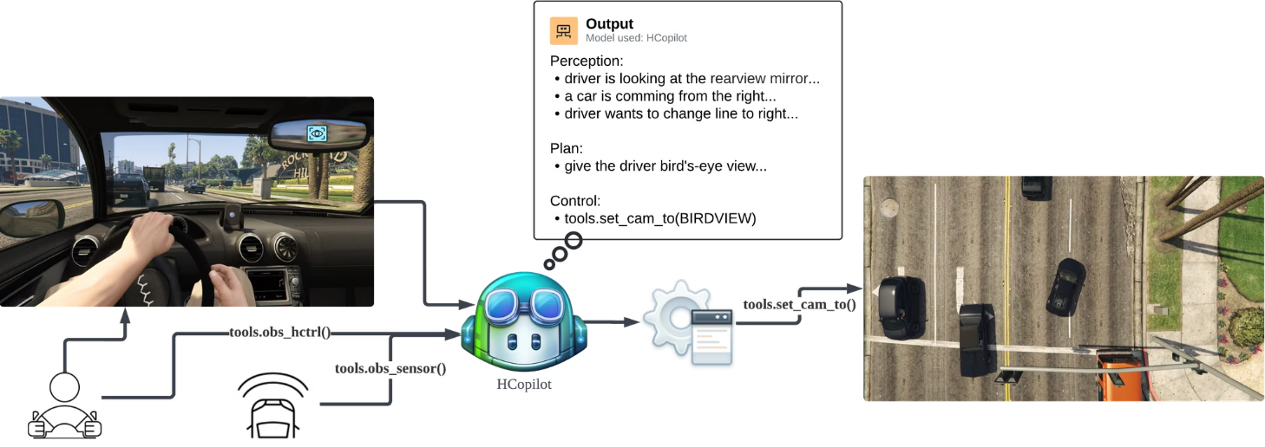
Scenario 1: Lane Change

Slide 18
Scenario 2: Turn Right at Intersection 1

Slide 19
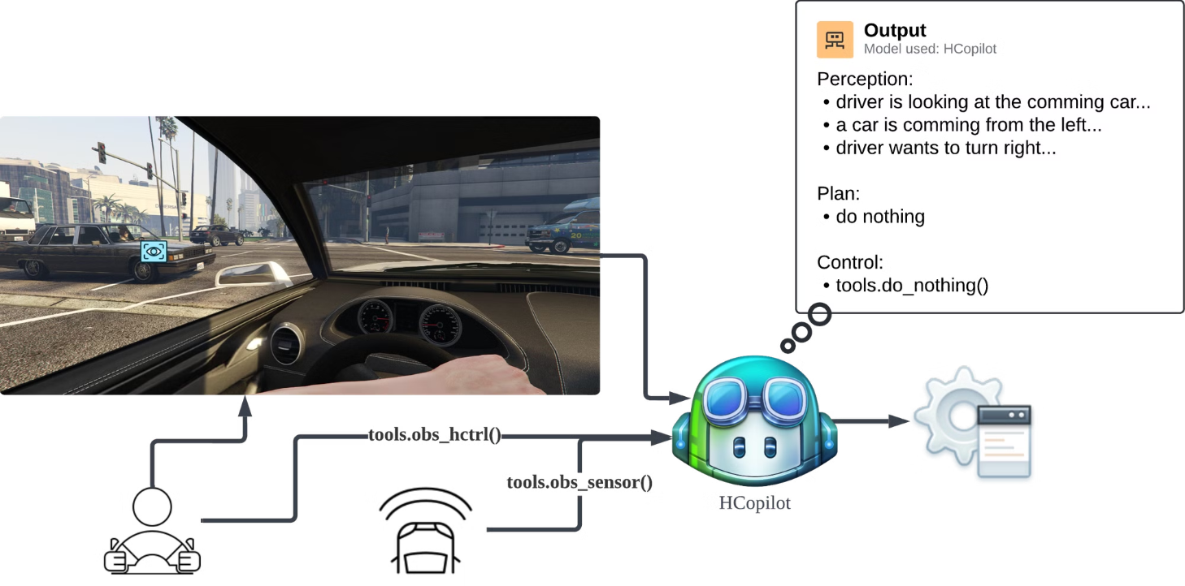
Scenario 2: Turn Right at Intersection 2

Slide 20
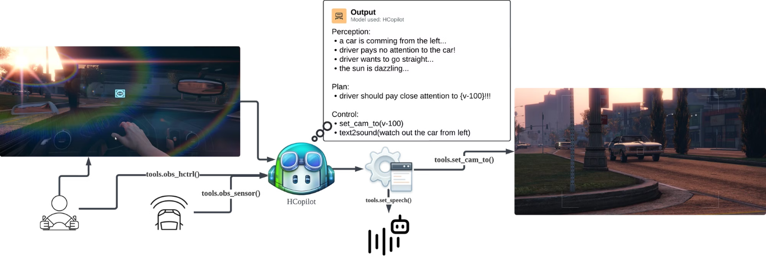
Scenario 3: Too Bright to See

Slide 21
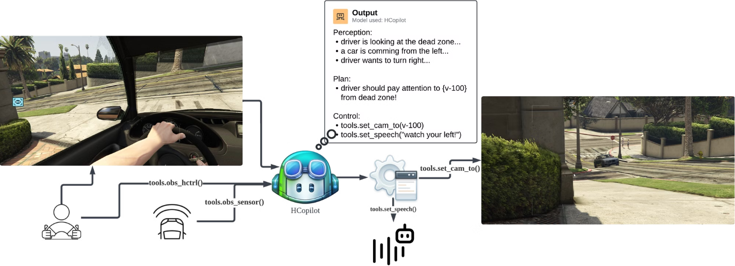
Scenario 4: Blind Area

Slide 22
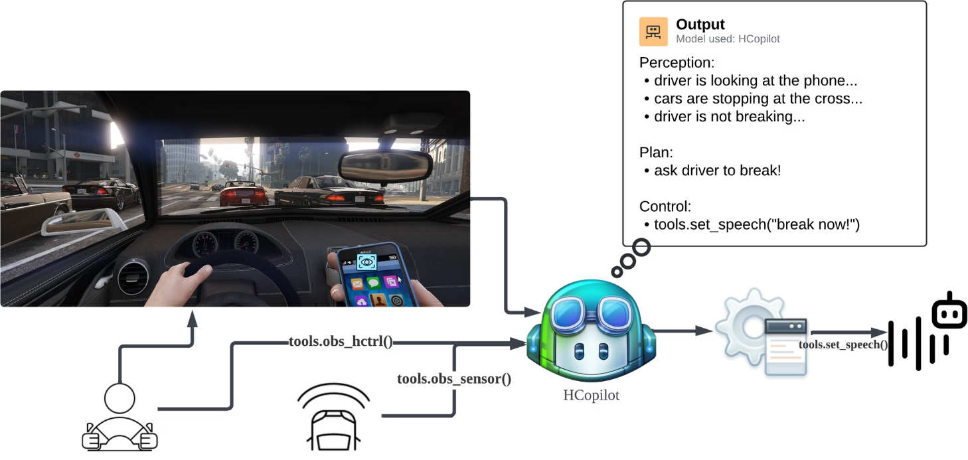
Scenario 5: Low Attention

Slide 23
Conclusion and Future Work
Conclusion
Future Work

Slide 24

Thank You!

